Slide 1
Course Name:-Software Metrics Chapter one: Overview of software metrics compiled by Samuel. A

Slide 2
Outline
What is measurement?
Measurement in Everyday Life
Measurement in Software Engineering
Neglect of Measurement in Software Engineering
Objectives for Software Measurement
Why Measure Software?
What is Software Metric
Motivation for Metrics
Scope of Software Metrics
Key Metrics to Monitor Your React Native App’s Performance

Slide 3
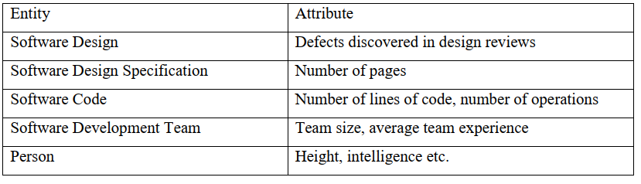
What is measurement?
It is the process by which numbers or symbols are assigned to attributes of entities in the real world, in such a way as to describe them according to clearly defined rules.
measurement captures the information about the attributes of entities
Examples of Entities and Attributes

Slide 4
Measurement in Software Engineering
Software measurement is an essential component of good software engineering.
Many of the best software developers measure characteristics of their software to get some sense of whether:
the requirements are consistent and complete,
the design is of high quality, and
the code is ready to be released

Slide 5
Measurement in Software Engineering cont,,
Effective project managers measure attributes of processes and products to be able to tell when software will be ready for delivery and whether a budget will be exceeded.
Organizations use process evaluation measurements to select software suppliers.
Informed customers measure the aspects of the final product to determine:
if it meets the requirements and is of sufficient quality.
Finally, maintainers must be able to assess the current product to see what should be upgraded and improved

Slide 6
Why Measure Software?
Determine the quality of the current product or process
Predict qualities of a product/process
Improve quality of a product/process

Slide 7
Objectives for Software Measurement
Here the kinds of information needed to understand and control a software development project, from both manager and developer perspectives 1. Managers: What does each process cost? How productive is the staff? How good is the code being developed? Will the user be satisfied with the product? How can we improve? 2. Developers: Are the requirements testable? Have we found all the faults? Have we met our product or process goals? What will happen in the future?

Slide 8
Neglect of Measurement in Software Engineering
In many instances, measurement is considered a luxury in software development. This lead for the following failures in many projects:
We fail to set measurable targets for our software products
We fail to understand and quantify the component cost of software projects
We do not quantify or predict the quality of the products we produce
Too much reliance

Slide 9
Biggest Information Technology Failures
A large drug wholesaler failed large implementation of ERP
In the early 90s, FoxMeyer, a healthcare service company. The IT system, a multi-million dollar project, was the first of its kind launched in the pharmaceutical industry. The implementation cost for was budgeted at $65 million
This failure was the result of poor planning and implementation.

Slide 10
Biggest Information Technology Failures
A large drug wholesaler failed large implementation of ERP
In the early 90s, FoxMeyer, a healthcare service company. The IT system, a multi-million dollar project, was the first of its kind launched in the pharmaceutical industry. The implementation cost for was budgeted at $65 million. This failure was the result of poor planning and implementation.
No restructuring of the business process
Insufficient testing
Overly ambitious project scope
Dominance of IT specialists’ own interest
Poor management support
Lack of end-user cooperation

Slide 11
Biggest Information Technology Failures
A $2 billion air traffic control system failed due to insufficient computer memory
The $2.4 billion system, made by Lockheed Martin Corp
On April 30, 2014, hundreds of LAX flights were delayed or canceled because all computers in the airport crashed due to a bug in the En Route Automation Modernization (ERAM) system.

Slide 12

Biggest Information Technology Failures

Slide 13
Biggest Information Technology Failures
The Ariane 5 launch became one of the biggest information technology failure
the rocket exploded, burst into a million pieces, and crashed into the open field.
The failure lead to an extra cost of $370 million and turned a large, potentially innovative project into burning little pieces of dust.

Slide 14

Biggest Information Technology Failures

Slide 15
Motivation for Metrics
Estimate the cost & schedule of future projects
Evaluate the productivity impacts of new tools and techniques
Establish productivity trends over time
Improve software quality
Forecast future staffing needs
Anticipate and reduce future maintenance needs

Slide 16
What is Software Metric
A software metric is a standard of measure of a degree to which a software system or process possesses some property.
Even if a metric is not a measurement (metrics are functions, while measurements are the numbers obtained by the application of metrics),

Slide 17
Cont,,
Metric - quantitative measure of degree to which a system, component or process possesses a given attribute. “A handle or guess about a given attribute.”
E.g., Number of errors found per person hours expended
Measure - quantitative indication of extent, amount, dimension, capacity, or size of some attribute of a product or process.
E.g., Number of errors

Slide 18
Cont,,
Software metrics is a standard of measure that contains many activities which involve some degree of measurement.
It can be classified into three categories:
product metrics,
process metrics, and
project metrics.
But Some metrics belong to multiple categories. For example, the in-process quality metrics of a project are both process metrics and project metrics.

Slide 19
Cont,
Product metrics describe the characteristics of the product such as size, complexity , design features, performance, and quality level.
Process metrics are the measures of various characteristics of the software development process. can be used to improve software development and maintenance.
For example, the efficiency of fault detection. They are used to measure the characteristics of methods, techniques, and tools that are used for developing software.

Slide 20
Cont,
Project metrics describe the project characteristics and execution. Examples include the number of software developers, the staffing pattern over the life cycle of the software, cost, schedule, and productivity
Project metrics are the metrics used by the project manager to check the project's progress. Data from the past projects are used to collect various metrics, like time and cost; these estimates are used as a base of new software.
these metrics are used to decrease the development costs, time efforts and risks.

Slide 21
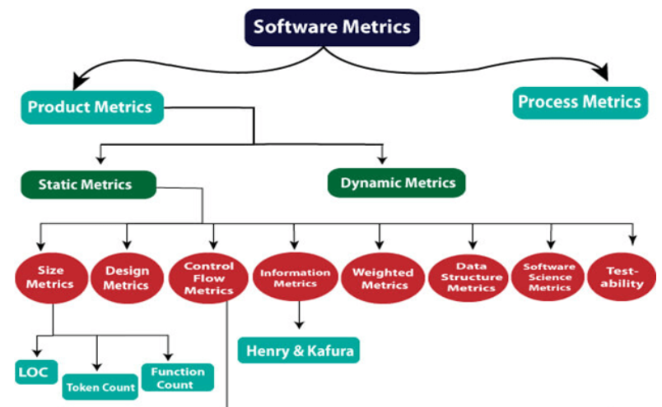
Cont,

Slide 22
Scope of Software Metrics
Software metrics contains many activities which include the following:-
Cost and Effort Estimation:-Effort is expressed as a function of one or more variables such as the size of the program, the capability of the developers and the level of reuse.
Cost and effort estimation models have been proposed to predict the project cost during early phases in the software life cycle.
The different models proposed are –
Boehm’s COCOMO model
Putnam’s slim model
Albrecht’s function point model

Slide 23
Cont,,
Productivity Model and Measures :-Productivity can be considered as a function of the value and the cost.
Each can be decomposed into different measurable size, functionality, time, money, etc.
Different possible components of a productivity model can be expressed in the following diagram.

Slide 24
Cont,,
Data Collection
The quality of any measurement program is clearly dependent on careful data collection.
Data collected can be distilled into simple charts and graphs so that the managers can understand the progress and problem of the development.
Data collection is also essential for scientific investigation of relationships and trends.

Slide 25
Cont,,
Quality Models and Measures
Quality models have been developed for the measurement of quality of the product without which productivity is meaningless.
These quality models can be combined with productivity model for measuring the correct productivity.
The upper branches hold important high-level quality factors such as reliability and usability.
The notion of divide and conquer approach has been implemented as a standard approach to measuring software quality

Slide 26
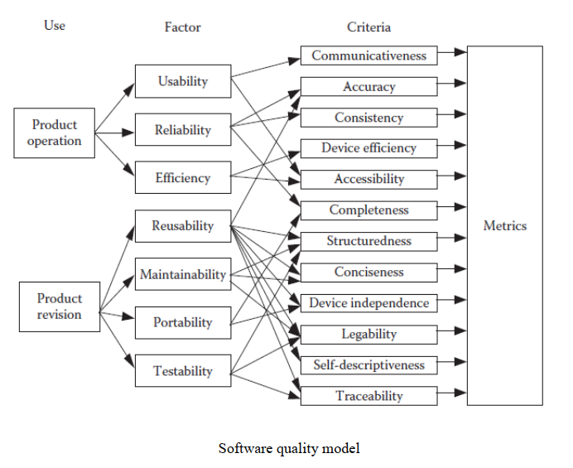

Slide 27
Reliability Models
The basic problem in reliability theory is to predict when a system will eventually fail.
A software reliability model indicates the form of a random process that defines the behavior of software failures to time.
Software reliability models have appeared as people try to understand the features of how and why software fails, and attempt to quantify software reliability.

Slide 28
Performance Evaluation and Models
It includes externally observable system performance characteristics such as response times and completion rates, and the internal working of the system such as the efficiency of algorithms.

Slide 29
Cont,
Capability Maturity Assessment
This model can assess many different attributes of development including the use of tools, standard practices and more.
It is based on the key practices that every good contractor should be using

Slide 30
Cont,,
Management by Metrics
For managing the software project, measurement has a vital role. For checking whether the project is on track, users and developers can rely on the measurement-based chart and graph.
measurement is an important part of software project management. Customers and developers alike rely on measurement-based charts and graphs to help them decide if a project is on track.
Evaluation of Methods and Tools
This depends on the experimental design, proper identification of factors likely to affect the outcome and appropriate measurement of factor attributes.

Slide 31
Question,,
What product, process and project metrics do big tech companies (Google, Facebook, Netflix etc.) use?

Slide 32
Chapter two: Measurement basics
Contents
Metrology
Direct and Indirect Measurement
Measurement quality
Measurement scales and scale types
Measuring Software Quality using Quality Metrics
Google’s HEART Framework for Measuring UX
Validating the Measurement Systems

Slide 33
Metrology
Metrology is “the science of measurement, embracing both experimental and theoretical determinations at any level of uncertainty in any field of science and technology,” as defined by the International Bureau of Weights and Measures (BIPM, 2004).

Slide 34
Metrology..
Metrology can be divided into three subfields: scientific metrology, applied metrology, and legal metrology.
Legal metrology is the end of the line, concerning regulatory requirements of well established measurements and measuring instruments for the protection of consumers and fair trade.
In applied metrology, the measurement science is developed toward manufacturing and other processes, ensuring the suitability of measurement instruments, their calibration, and quality control.
Scientific metrology is the basis of all subfields, and concerns the development of new measurement methods, the realization of measurement standards, and the transfer of these standards to users.

Slide 35
What are the Software attributes and How we measure it?
Unfortunately, we have no comparably deep understanding of software attributes.
Nor do we have the associated sophisticated measurement tools.
Questions that are relatively easy to answer for non-software entities are difficult for software. For example, consider the following questions:
How much must we know about an attribute to consider measuring (e.g., program complexity)?

Slide 36
Many systems consist of programs in a variety of languages. For example, the GNU/Linux distribution includes code written in at least 19 different languages (Wheeler 2002).
In order to deal with code written in such a variety of languages, David Wheeler’s code analysis tool uses a simple scheme for counting LOC:
“a physical source line of code is a line ending in a newline or end-of-file marker, and which contains at least one non whitespace non-comment character.

Slide 37
Measuring lines of code
Are non-executable lines counted?
Declarations
Compiler Directives
Comments
Blank lines

Slide 38
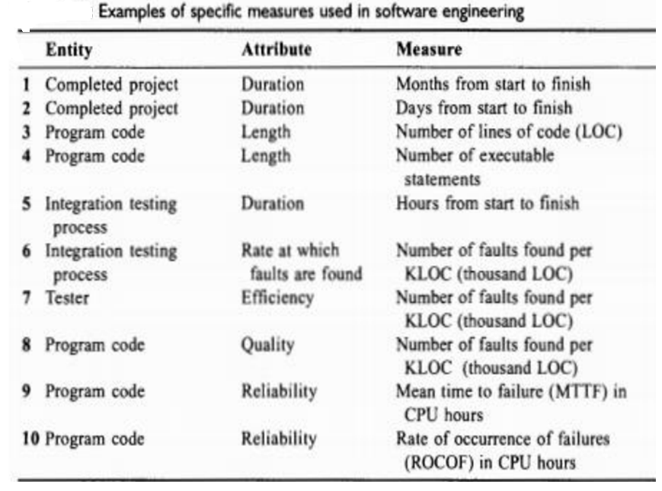

Slide 39
Direct and Indirect Measurement
Direct measure – relates an attribute to a number or symbol without reference to no other object or attribute.
Direct measurement of an attribute of an entity involves no other attribute or entity.
For example, length of a physical object can be measured without reference to any other object or attribute.

Slide 40
Direct and Indirect Measurement
Indirect measure -used when an attribute must be measured by combining several of its aspects (e.g., density).
measures of the density of a physical object can be derived in terms of mass and volume; we then use a model to show us that the relationship between the three is Density = Mass/Volume.
Requires a model of how measures are related to each other

Slide 41
Direct
Size of source code (measured by LOC)
Schedule of the testing process (measured by elapsed time in hours)
Number of defects discovered (measured by counting defects)
Time a programmer spends on a project (measured by months worked)
Indirect/ derived measures that are commonly used in software engineering.
Programmer productivity (LOC/work months of effort)
Module defect density (number of defects/module size)
Defect detection efficiency (# defects detected/total defects)
Requirements stability (initial # requirements/total # requirements)
Test effectiveness ratio (number of items covered/total number of items)
System spoilage (effort spent fixing faults/total project effort)

Slide 42
The most common of all, and the most controversial, is the measure for programmer productivity, as it emphasizes size of output without taking into consideration the code’s functionality or complexity.
The defect detection efficiency measure is computed with respect to a specific testing or review phase; the total number of defects refers to the total number discovered during the entire product life cycle.
Japanese software developers routinely compute the system spoilage measure; it indicates how much effort is wasted in fixing faults, rather than in building new code.

Slide 43
Measurement scale types
Reading Assignment
Nominal
Ordinal
Interval
Ratio
Absolute

Slide 44
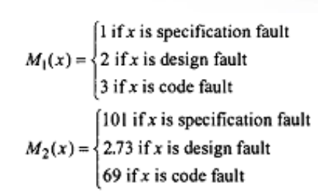
1.Nominal
define classes or categories, and place each category in a particular class or category
nominal scale measurement places elements in a classification scheme. The classes are not ordered; even if the classes are numbered from 1 to n for identification, there is no implied ordering of the classes.

Slide 45
2.Ordinal scale
Augments nominal scale with ordering information.
We can often augment the nominal scale with information about an ordering of the classes or categories creating an ordinal scale.
The ordering leads to analysis not possible with nominal measures.
The ordinal scale has the following characteristics:

Slide 46
2.Ordinal scale
The empirical relation system consists of classes that are ordered with respect to the attribute.
Any mapping that preserves the ordering is acceptable.
The numbers represent ranking only, so addition, subtraction, and other arithmetic operations have no meaning

Slide 47
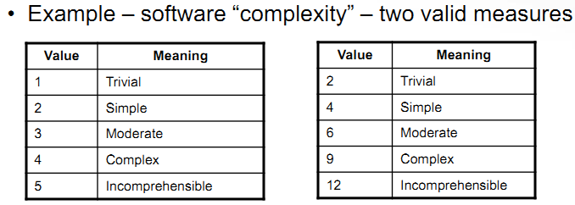
2.Ordinal scale

Slide 48
3.Interval scale
Captures information about size of intervals that separate classes.
Example – program length can be measured by lines of code, number of characters, etc. Number of characters may be obtained by multiplying the number of lines by the average number of characters per line

Slide 49
3.Interval scale
We have seen how the ordinal scale carries more information about the entities than does the nominal scale, since ordinal scales preserve ordering. The interval scale carries more information still, making it more powerful than nominal or ordinal.
This scale captures information about the size of the intervals that separate the classes, so that we can in some sense understand the size of the jump from one class to another.

Slide 50
3.Interval scale
an interval scale can be characterized in the following way
An interval scale preserves order, as with an ordinal scale.
An interval scale preserves differences but not ratios. That is, we know the difference between any two of the ordered classes in the range of the mapping, but computing the ratio of two classes in the range does not make sense.
Addition and subtraction are acceptable on the interval scale, but not multiplication and division

Slide 51
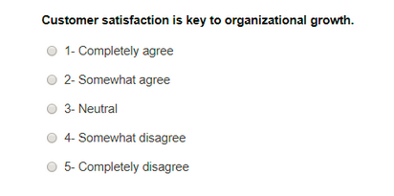
3.Interval scale
One of the most commonly used interval scale questions is arranged on a five-point Likert Scale question, where each emotion is denoted with a number, and the variables range from extremely dissatisfied to extremely satisfied.

Slide 52
4.Ratio Scale
Although the interval scale gives us more information and allows more analysis than either nominal or ordinal, we sometimes need to be able to do even more.
For example, we would like to be able to say that one liquid is twice as hot as another, or that one project took twice as long as another.
This need for ratios gives rise to the ratio scale, the most useful scale of measurement, and one that is common in the physical sciences.

Slide 53
4.Ratio Scale
A ratio scale has the following characteristics:
It is a measurement mapping that preserves ordering, the size of intervals between entities, and ratios between entities.
There is a zero element, representing total lack of the attribute.
The measurement mapping must start at zero and increase at equal intervals, known as units.
All arithmetic can be meaningfully applied to the classes in the range of the mapping

Slide 54
4.Ratio Scale
Ratio Scale Examples
What is your height in feet and inches?
Less than 5 feet.
5 feet 1 inch – 5 feet 5 inches
5 feet 6 inches- 6 feet
More than 6 feet

Slide 55
5.Absolute scale
The absolute scale has the following properties:
The measurement for an absolute scale is made simply by counting the number of elements in the entity set.
The attribute always takes the form “number of occurrences of x in the entity.”
There is only one possible measurement mapping, namely the actual count, and there is only one way to count elements

Slide 56
5.Absolute scale
lines of code in a module is an absolute scale measure
the number of failures observed during integration testing can be measured only in one way: by counting the number of failures observed.
Likewise, the number of people working on a software project can be measured only in one way: by counting the number of people.

Slide 57
5.Absolute scale
Since there is only one possible measure of an absolute attribute, the set of acceptable transformations for the absolute scale is simply the identity transformation.
The uniqueness of the measure is an important difference between the ratio scale and absolute scale.

Slide 58
Measuring Software Quality using Quality Metrics
In Software Engineering, Software Measurement is done based on some Software Metrics where these software metrics are referred to as the measure of various characteristics of a Software.
In Software engineering Software Quality Assurance (SAQ) assures the quality of the software. Set of activities in SAQ are continuously applied throughout the software process. Software Quality is measured based on some software quality metrics.
There is a number of metrics available based on which software quality is measured. But among them, there are few most useful metrics which are most essential in software quality measurement.

Slide 59
Measuring Software Quality using Quality Metrics..
1. Code Quality – Code quality metrics measure the quality of code used for the software project development. In code quality both Quantitative metrics like the number of lines, complexity, functions, rate of bugs generation, etc, and Qualitative metrics like readability, code clarity, efficiency, maintainability, etc are measured.
2. Reliability – Reliability metrics express the reliability of software in different conditions. The software is able to provide exact service at the right time or not is checked. Reliability can be checked using Mean Time Between Failure (MTBF) and Mean Time To Repair (MTTR).

Slide 60
Measuring Software Quality using Quality Metrics..
3. Performance – Performance metrics are used to measure the performance of the software. Each software has been developed for some specific purposes. Performance metrics measure the performance of the software by determining whether the software is fulfilling the user requirements or not, by analyzing how much time and resource it is utilizing for providing the service.
4. Usability – Usability metrics check whether the program is user-friendly or not. Each software is used by the end-user. So it is important to measure that the end-user is happy or not by using this software.

Slide 61
Measuring Software Quality using Quality Metrics..
5. Correctness – Correctness is one of the important software quality metrics as this checks whether the system or software is working correctly without any error by satisfying the user. Correctness gives the degree of service each function provides as per developed.
6. Maintainability – Each software product requires maintenance and up-gradation. Maintenance is an expensive and time-consuming process. So if the software product provides easy maintainability then we can say software quality is up to mark. Maintainability metrics include time requires to adapt to new features/functionality, Mean Time to Change (MTTC), performance in changing environments, etc.

Slide 62
Measuring Software Quality using Quality Metrics..
7. Integrity – Software integrity is important in terms of how much it is easy to integrate with other required software’s which increases software functionality and what is the control on integration from unauthorized software’s which increases the chances of cyberattacks.
8. Security – Security metrics measure how much secure the software is? In the age of cyber terrorism, security is the most essential part of every software. Security assures that there are no unauthorized changes, no fear of cyber attacks, etc when the software product is in use by the end-user.

Slide 63
Google’s HEART Framework for Measuring UX
What the research team from Google noted was that while small scale frameworks were common place measuring the experience on a large scale via automated means had no framework in place.
Thus the Heart Framework is specifically targeted at that kind of measurement.

Slide 64
Google’s HEART Framework for Measuring UX
The Heart Metrics
There are five metrics used in the HEART framework:
Happiness
Engagement
Adoption
Retention
Task Success

Slide 65
Google’s HEART Framework for Measuring UX
Happiness
As you might expect this is a measure of attitude or satisfaction. You’re most likely to record satisfaction on large scale projects through some sort of user survey. An example cited in the report shows that change can impinge on happiness and that an initial drop in happiness following a change does not necessarily have long-term implications.

Slide 66
Google’s HEART Framework for Measuring UX
Engagement
This is a measure of how much a user interacts with a product, of their own volition. As we’ve noted already – it may be a poor metric for enterprise systems because there’s no optional element in usage patterns. If you’ve got to do a job; you’ve got to do the job – whether you like the tool you’re doing the job with or not.

Slide 67
Google’s HEART Framework for Measuring UX
Adoption
Adoption is defined as the number of new users over a certain time frame. It’s a measure of how successful you are at attracting new business. It might be argued, and we can certainly see how, that this is less a measure of user experience and more a measure of customer experience.

Slide 68
Google’s HEART Framework for Measuring UX
Retention
Retention, on the other hand, is a matter of keeping your existing users for x amount of time. That might be an indefinite amount of time for products with long-term utility. However, you’re probably going to want to look at other time scales to work out where drop out from a service is most pronounced so that you can tackle the UX issues that lead to that drop out. A week, a month, a quarter, a year, are all perfectly reasonable intervals as are any other intervals that you can justify as relevant to your business.

Slide 69
Google’s HEART Framework for Measuring UX
Task Success
task success” can be broken down into more subtle components. You might want to examine time spent on any given task (can the process be improved?) or the percentage of successful completions of a specific task once it has begun (e.g. checkout processes or registration processes).
Remote usability testing and benchmarking studies are recommended for measuring these on a large scale.

Slide 70
Thank you

